Slide 1
Econ 100 Principles of Economics
Lecture 8
March 22

Slide 2
Two questions
Rationality assumption:
Do individuals always maximize net benefit?
Ultimatum bargaining
Dictator game
Consequences of rationality:
What are the social consequences of individuals’ behaving rationally?
Tragedy of commons
Invisible hand by Adam Smith: market mechanism (demand/supply)

Slide 3
Ultimatum Game
Offer | # of offers (total: 29) | # rejections
1 | 5 | 2
5 | 1 | 1
15 | 3 | 2
17,3 | 1 | 0
19 | 1 | 0
20 | 4 | 1
24 | 2 | 0
25 | 8 | 0
30 | 1 | 0
35 | 1 | 0
45 | 1 | 0
49 | 1 | 0
Mean offer | Mode offer | Rejection rate | Low offer Rejection rate
29.14 | 25 | % 20.7 | % 50

Slide 4
Split or steal
Players' payoff (in £1,000)
 | Split | Steal
Split | 50, 50 | 0, 100
Steal | 100, 0 | 0, 0

Slide 5
Public Good Contribution Game
Each player decides whether to contribute $20 or zero.
Each player receives %75 of the cash in the pool plus the money she keeps if any.
 | Contribute | Keep
Contribute | 30, 30 | 15, 35
Keep | 35, 15 | 20, 20

Slide 6
Prisoner's dilemma
Players' payoff
 | Deny | Confess
Deny | 3 years, 3 years | 25 years, 1 year
Confess | 1 year, 25 years | 10 years, 10 years

Slide 7
TRAGEDY of the COMMONS

Slide 8
Tragedy of the Commons: Definition
The tragedy of the commons is the depletion of a shared resource by individuals, acting independently and rationally according to each one's self-interest, despite their understanding that depleting the common resource is contrary to the group's long-term best interests.
Medieval land tenure in Europe, of herders sharing a common parcel of land, on which they are each entitled to let their cows graze. It is in each herder's interest to put the next (and succeeding) cows he acquires onto the land, even if the quality of the common is damaged for all as a result, through overgrazing. The herder receives all of the benefits from an additional cow, while the damage to the common is shared by the entire group. If all herders make this individually rational economic decision, the common will be depleted or even destroyed, to the detriment of all.

Slide 9
Tragedy of the Commons: Example
There is a fishery with 100 fishes in it and there are 10 fishermen fishing there. Each is able to catch 10 fish. Each fisherman makes more profit more he fishes. But if each catches 10 fish, the fishery will become empty forever. As long as around 50% of the fishes are not caught (i.e. each catches 5), the fishery is sustainable.
The crux is that from a social perspective (and also from individual perspective in the long run), the best strategy is that each catches 5 fish. But from an individual's perspective in the short run, the best strategy is to catch as many as he can (i.e. 10 fish). But if each fisherman follows this latter strategy, the fishery will be empty forever. The result is the tragedy of the common resource (fishery).

Slide 10

Solutions
Widely, privatization of these common pool resources (CPR) are proposed.
But, the works by Elinor Ostrom (2009 Nobel laureate) suggest that in real life, people who have access to the CPR are quite successful to develop institutions by themselves to preserve the CPR and avoid the tragedy of the commons; this way, socially desirable outcomes are achieved via cooperation.
"Governing the commons: The evolution of institutions for collective action" Elinor Ostrom, Cambridge University Press, 1990.

Slide 11
PRICES: Demand-Supply

Slide 12
Prices
Where do prices come from?
How is the price determined?
There are different mechanisms to set the price.
Government decides on the wages of the public workers.
Picasso’s paintings are sold on auctions.
To sell/buy an organ is illegal; one can not talk about the price of a kidney.
A more interesting example is the price mechanism through which the price of gold is determined.

Slide 13
Invisible hand
The story by Adam Smith: All our needs\wants can be found in the market place because of individuals’ drive to maximize their utility and firms’ drive to maximize their profits.
The question remains: How are the prices of all these commodities and services are determined?
Is it the following: the gold producer calculates the cost of one gram of gold, considers all other costs related to its production, thinks of a profit margin and finally sets the price?

Slide 14
Food prices
http://www.fao.org/worldfoodsituation/foodpricesindex/en/
FAO Food Price Index
The FAO Food Price Index is a measure of the monthly change in international prices of a basket of food commodities.
The FAO Food Price Index* (FFPI) averaged 150.4 points in January 2016, down almost 3 points (1.9 percent) from December and as much as 29 points (16 percent) below January 2015. The prices of all the commodities tracked by the Index fell, with sugar and dairy products registering the steepest declines.

Slide 15
Food Price Increases
The FAO food price index which covers the prices of the most important food commodities showed a price increase of 71% during the 15 months between the end of 2006 and March 2008.
The increase was particularly dramatic for rice and cereals where the prices sky-rocketed to a peak of 126% in this time period.
Later the index decreased for a short while and after 2010, it is on the rise again.

Slide 16
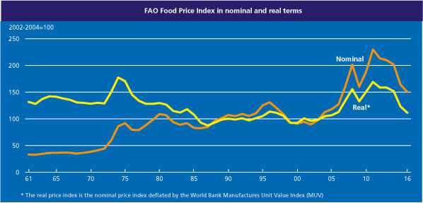
Food prices over the last 45 years

Slide 17
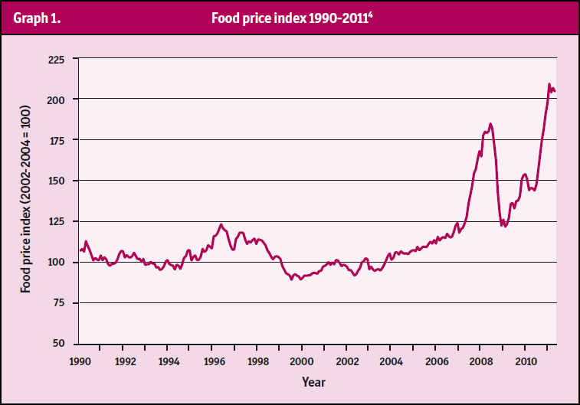
Food Price Increases

Slide 18
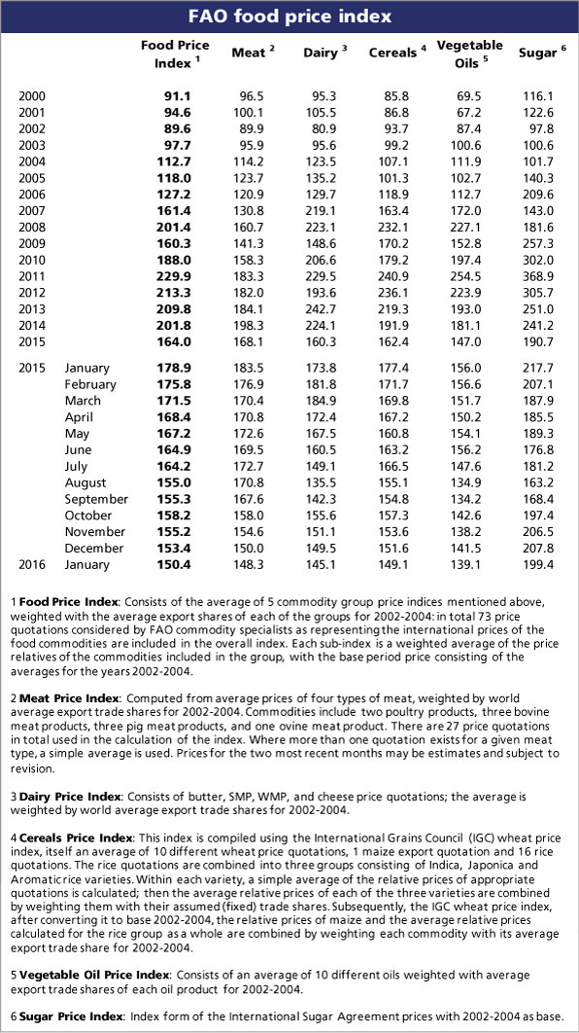

Slide 19
Food price increases btw 2006-08
Commodity | Price increase from start 2006 to mid-2008
Maize | 180 %
Wheat | 110 %
Oil | 110 %
Cocoa | 90 %
Coffee | 70 %
Cotton | 30 %
Sugar | 10 %

Slide 20
A different story since 2011
Agricultural prices, as measured by the FAO’s price index, have fallen almost 30 per cent since 2011 as a result of increased production.
But the FAO acknowledges that extreme weather could still introduce some turbulence to global commodities markets. In Indonesia, El Niño caused the opposite problem to Brazil — excessive dryness, which affected the production of palm oil and briefly pushed up prices.

Slide 21
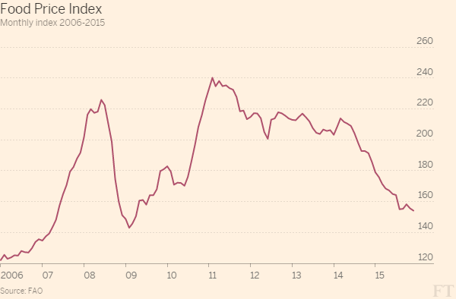

Slide 22
Food Price Increases
The proportion of expenditure for food in a typical household budget:
10%-20% in the industrial countries,
60%-80% in the LDC’s (FAO 2008).
It is estimated that the food price spike increased the number living in poverty by between 100 and 200 million.

Slide 23
Food Price Increases
High food prices led to the number of chronically malnourished people increasing by 75 million in 2007 and a further 40 million in 2008.
The latest estimate by the Food and Agriculture Organisation (FAO) in June 2009 was that over 1 billion people are now chronically malnourished due to “global economic slowdown combined with stubbornly high food prices”

Slide 24
Food Price Increases
Food price increases also have negative macroeconomic effects:
A 50% price increase on basic food leads to a mere 6% rise in expenditure for a high income country, but it amounts to 21% for a food importing country of low income (U.S. Department for Agriculture. Economic Research Service. 2008: p. 25).
The balance of payments of food importers deteriorates causing the danger of debt.
The food price increases stimulate inflation. According to UN estimates, they account for up to a third to more than one half of the nominal rate of inflation in developing countries, particularly in Asia.

Slide 25
Food Price Increases
Why did the food prices increase dramatically?
Increasing consumption of dairy products in the developing countries
Agricultural productivity
Production of agro-fuels (ethanol and biodiesel)
The reduction of food stocks (particularly in the EU)
The increase in the oil prices
Weather (La Nina-cooling of equatorial Pacific, flood in Australia, etc.)
Export restrictions on food by governments
Speculation

Slide 26
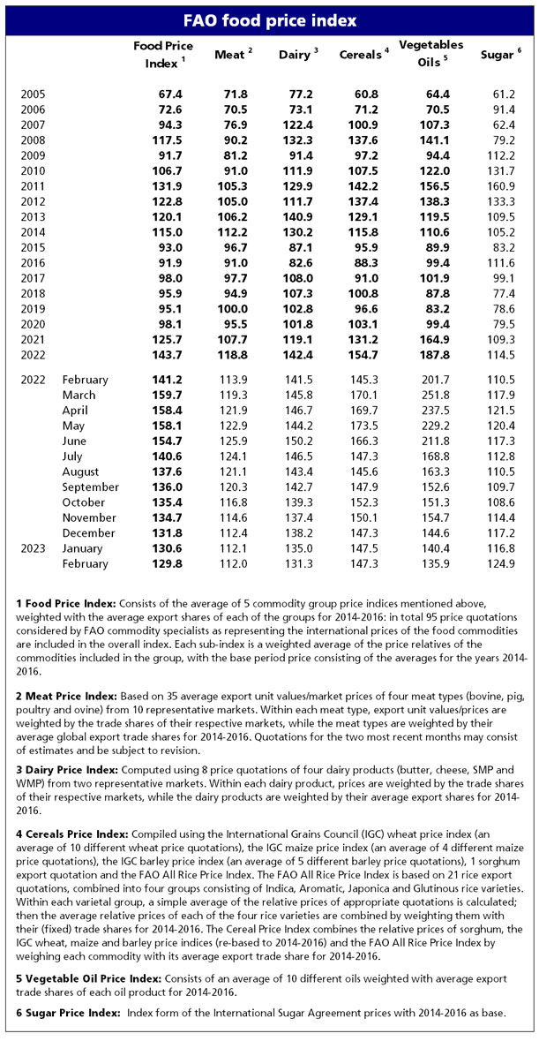

Slide 27
Food Price Increase? Why recently?
Pandemic
Change in consumer food consumption
Trade pattern disruptions
Workforce restrictions
War in Ukraine
Sanctions on Russia

Slide 28
Food Price Increases
To be able to explain the food price increases is impossible without knowing demand and supply.

